Slide 1

ANZ DATA-VIRTUAL INTERNSHIP
VAMSI VASAMSETTI

Slide 2
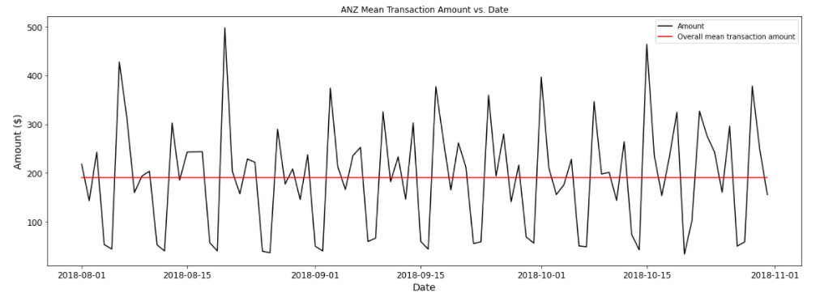
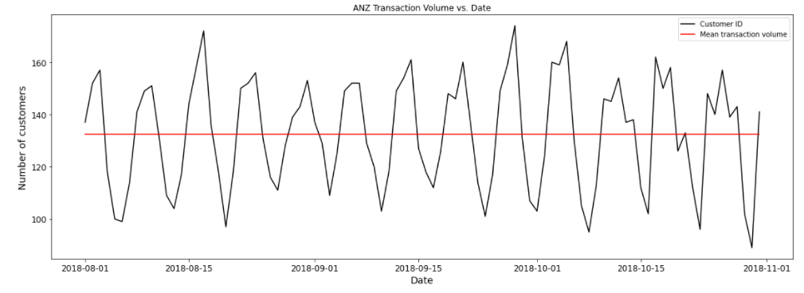
ANZ Mean Transaction Amount vs Date
Overall mean transaction amount~$200
ANZ Transaction Volume vs Date
Mean transaction volume(customers)
~133 Customers

Slide 3
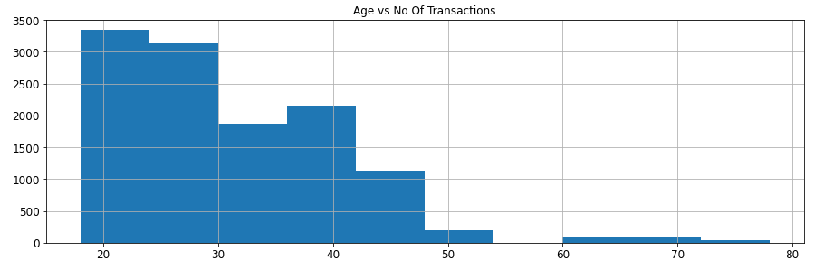
Age vs No of Transactions:
We can see that as age increases the no of transactions is decreasing.

Slide 4
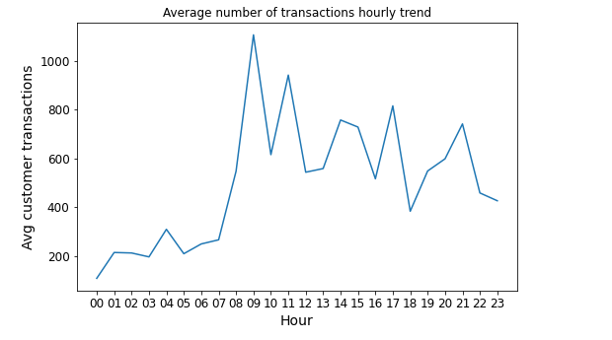
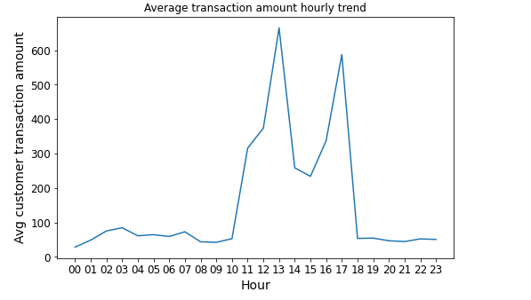
Average No of Transactions hourly trend vs
Avg customer transactions:
Avg. Customer Transactions is highest around 9 AM.
Average No of Transactions hourly trend vs
Avg customer transaction amount:
Avg Customer Transaction Is highest around
12:30 pm and the transaction amount being ~$670

Slide 5
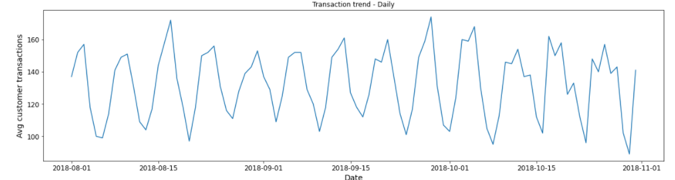
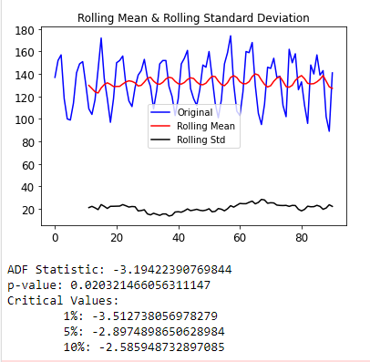
Insights - Customer Transaction Amount Spent daily Trend
1)ADF of -3.2 < Critical value @ 5%.Therefore No of transactions on any given day and it’s rolling average mean are stationary.
2)P value is less than 0.05.
3)Highest number of transactions are done on Fridays & lowest on Mondays.

Slide 6
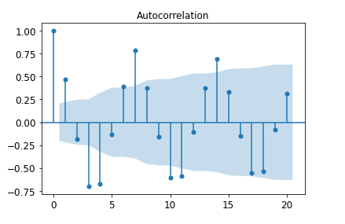
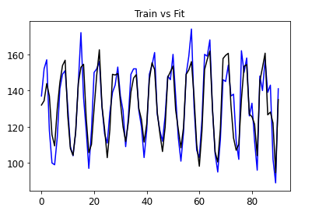
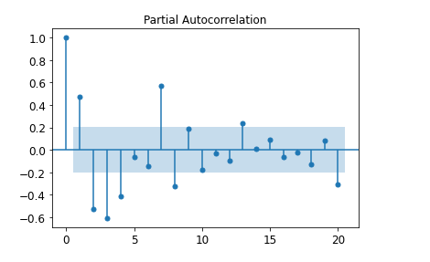
Insights - Customer Transaction Amount Spent daily Trend
Pattern repeats every 7 days i.e, Autocorrelation=7 days.Therefore customers tend to repeat the same number of transactions on particular days of the week
Given strong auto-correlation & stationarity of the customer daily transaction volume, transaction behavior of customer is highly predictable over short range.

Slide 7
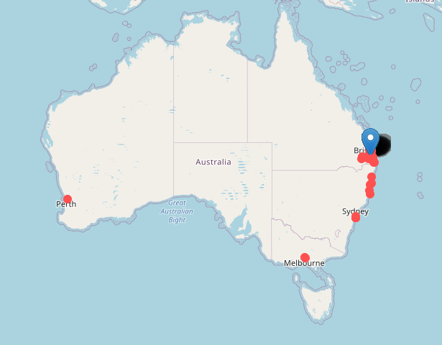
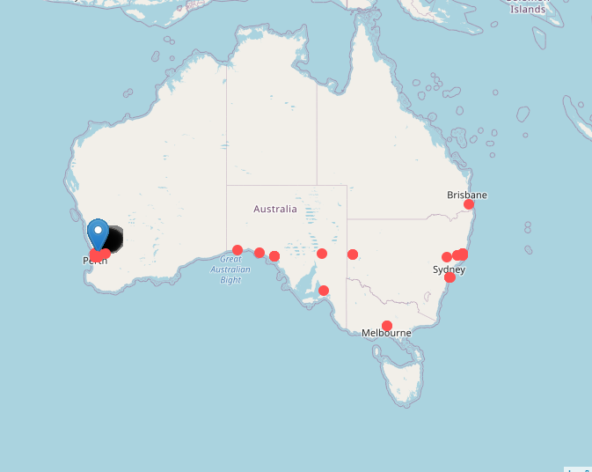
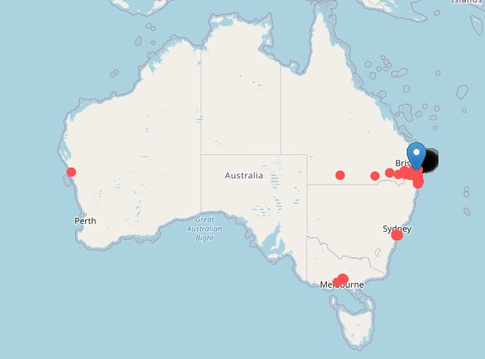
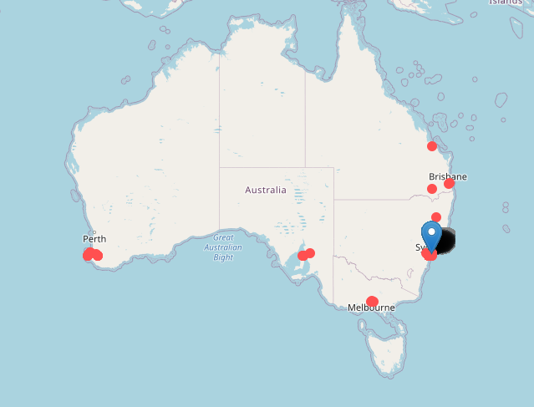
LOCATION ANALYSIS
These maps show top customers with most ‘POS/POS SALE’ transaction by volume (above).
Useful for fraud detection.

